Slide 1
FAMILIES WITH HOPE
SAMUEL & WIRDIS PEGUERO

Slide 2
LESSON 12: NEW LIFE STYLE
One afternoon, sitting on the couch at home, Ernest and Martha told their children about the experiences they had to gone through when they decided to move out of their country and move to New York City. Ernest enthusiastically told them that although the idea was not easy, he thought that one day the project would be beneficial to his potential family..

Slide 3
LESSON 12: NEW LIFE STYLE
When they finally arrived at the proposed place, they realized that this implied much more than simply moving.
They were adopting a new lifestyle. There, they found new friends who became their new family. They enjoyed new food, the language was different, and even the schedule had changed. Adapting was a process but they understood that the decision had been for the best and they were happy about it.
.

Slide 4
LESSON 12: NEW LIFE STYLE
1. What work does God do with those who give themselves to him with faith? 2 Corinthians 5:17.
«Therefore if any man be in Christ, he is a new creature: old things are passed away; behold, all things are become new».
Answer…

Slide 5
LESSON 12: NEW LIFE STYLE
2. Once the Christian career has begun, what does Jesus say to his believers? John 15: 4-5; Matthew 24:13.
Abide in me, and I in you. As the branch cannot bear fruit of itself, except it abide in the vine; no more can ye, except ye abide in me…
Answer…

Slide 6
LESSON 12: NEW LIFE STYLE
I am the vine, ye are the branches: He that abideth in me, and I in him, the same bringeth forth much fruit: for without me ye can do nothing.».
«But he that shall endure unto the end, the same shall be saved».
Answer…

Slide 7
LESSON 12: NEW LIFE STYLE
3. What principle does the Apostle Paul recommend when dressing? 1 Timothy 2:9.
«In like manner also, that women adorn themselves in modest apparel, with shamefacedness and sobriety; not with broided hair, or gold, or pearls, or costly array;».
Answer…

Slide 8
LESSON 12: NEW LIFE STYLE
4. Why do we recommend taking care of our body? 1 Corinthians 6:19-20; 10:31.
« What? know ye not that your body is the temple of the Holy Ghost which is in you, which ye have of God, and ye are not your own?

Slide 9
LESSON 12: NEW LIFE STYLE
For ye are bought with a price: therefore glorify God in your body, and in your spirit, which are God's».
«Whether therefore ye eat, or drink, or whatsoever ye do, do all to the glory of God».
Answer…

Slide 10
LESSON 12: NEW LIFE STYLE
5. If I am already in Christ, will I no longer have any difficulties until he comes? John 16:33; James 1:2-3.
«These things I have spoken unto you, that in me ye might have peace. In the world ye shall have tribulation: but be of good cheer; I have overcome the world.».
Answer…

Slide 11
LESSON 12: NEW LIFE STYLE
«My brethren, count it all joy when ye fall into divers temptations; Knowing this, that the trying of your faith worketh patience».
Answer…

Slide 12
LESSON 12: NEW LIFE STYLE
6. What promise does God make to the victor? Revelations 2:10 (last part) 3:5.
Be thou faithful unto death, and I will give thee a crown of life».

Slide 13
LESSON 12: NEW LIFE STYLE
«He that overcometh, the same shall be clothed in white raiment; and I will not blot out his name out of the book of life, but I will confess his name before my Father, and before his angels.».
Answer…

Slide 14
Let’s Comment …
How can you help the new believer learn and understand the reality of God's presence on his daily journey to the Heavenly Canaan? How does that blessing extend to the whole family? Matthew 28:20; Acts 16:31

Slide 15
MY REACTION …
By understanding God's plan for my life and how much my family can benefit from it I resolve without delay to put my life in harmony with the eternal principles of the gospel of Christ. I am sure that the Lord will sustain me; therefore, from now on, "Me and my house will serve Jehovah."

Slide 16
PRAYER REQUESTS
My family and personal prayer requests…
______________.
______________.
______________.

Slide 17
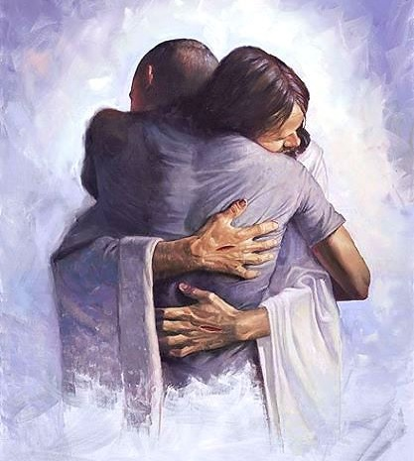
BLESSINGS TO YOUR FAMILY!
A BIG HUG
FOR YOU!

