Slide 1
FAMILIES WITH HOPE
SAMUEL & WIRDIS PEGUERO

Slide 2
LESSON 11: A NEW BEGINNING
Ernest and Martha’s eldest son had turned seven. After the loss of their youngest son, they prayed to the Lord for another baby and God granted it to them. Seeing the little face of his new brother, the eldest son had many questions and was excited about his "new baby brother," as he called him.

Slide 3
LESSON 11: A NEW BEGINNING
Oh, if I could only erase my story and start over. They wanted to share what they had learned, that our God has a plan that gives a new opportunity to those who wish to have a better future. We'll talk about that today.

Slide 4
LESSON 11: A NEW BEGINNING
1. What is the meaning of the statement Jesus made to Nicodemus? John 3:3-5.
«Jesus answered and said unto him, Verily, verily, I say unto thee, Except a man be born again, he cannot see the kingdom of God.
Nicodemus saith unto him, How can a man be born when he is old? can he enter the second time into his mother's womb, and be born?

Slide 5
LESSON 11: A NEW BEGINNING
Jesus answered, Verily, verily, I say unto thee, Except a man be born of water and of the Spirit, he cannot enter into the kingdom of God.».
Answer…

Slide 6
LESSON 11: A NEW BEGINNING
2. What example did Jesus give us regarding the way to be baptized? Matthew 3:16-17.
«And Jesus, when he was baptized, went up straightway out of the water: and, lo, the heavens were opened unto him, and he saw the Spirit of God descending like a dove, and lighting upon him:

Slide 7
LESSON 11: A NEW BEGINNING
And lo a voice from heaven, saying, This is my beloved Son, in whom I am well pleased.».
Answer…

Slide 8
LESSON 11: A NEW BEGINNING
3. What is the meaning of baptism? Romans 6:4.
«Therefore we are buried with him by baptism into death: that like as Christ was raised up from the dead by the glory of the Father, even so we also should walk in newness of life.».
Answer…

Slide 9
LESSON 11: A NEW BEGINNING
4. How are those who accept the gospel of Christ received in the family of God? Mark 16:15-16.
«And he said unto them, Go ye into all the world, and preach the gospel to every creature.
¹⁶ He that believeth and is baptized shall be saved; but he that believeth not shall be damned.».
Answer…

Slide 10
LESSON 11: A NEW BEGINNING
5. When the Word of God has been introduced, what message does the Lord give to the heart? Acts 22:16.
«And now why tarriest thou? arise, and be baptized, and wash away thy sins, calling on the name of the Lord».
Answer…

Slide 11
LESSON 11: A NEW BEGINNING
6. By accepting the Word of God in his heart, what important question did the Ethiopian ask Philip? Acts 8:36.
«And as they went on their way, they came unto a certain water: and the eunuch said, See, here is water; what doth hinder me to be baptized?».
Answer…

Slide 12
Let’s Comment…
Many people see baptism as a reward for someone who has acted well in life. If this was the case, who would need it then? What could be said of those who have tasted the bitter water of sin in its various forms? Could they also live the experience of being reborn in Christ? Matthew 11: 28-30

Slide 13
MY REACTION …
I accept Jesus' offer to experience a new beginning in my life. I believe that Jesus gave his life to save me from sin and its consequences. I decide to be baptized as Jesus was.

Slide 14
PRAYER REQUESTS
My family and personal prayer requests…
______________.
______________.
______________.

Slide 15
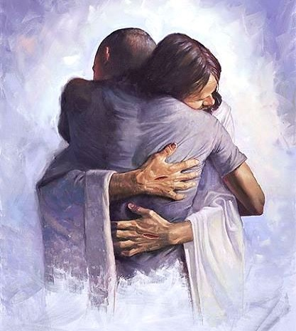
BLESSINGS TO YOUR FAMILY!
A BIG HUG
FOR YOU!

