Slide 1
FAMILIES WITH HOPE
SAMUEL & WIRDIS PEGUERO

Slide 2
LESSON 9: THE LONG-AWAITED DAY
What Ernest and Martha's children liked the most was vacation time. They longed for those days with much anticipation. As expected, they very much enjoyed vacation and didn’t want that precious time to end. Can you remember what your most precious vacation was?

Slide 3
LESSON 9: THE LONG-AWAITED DAY
Without a doubt, that is not even comparable to the most desired journey that awaits the great family of God. We are sure you will love being part of it. Let's see.

Slide 4
LESSON 9: THE LONG-AWAITED DAY
1. What was Jesus' greatest promise to his followers? John 14:1-3.
«Let not your heart be troubled: ye believe in God, believe also in me.
In my Father's house are many mansions: if it were not so, I would have told you. I go to prepare a place for you...

Slide 5
LESSON 9: THE LONG-AWAITED DAY
…And if I go and prepare a place for you, I will come again, and receive you unto myself; that where I am, there ye may be also.».
Answer…

Slide 6
LESSON 9: THE LONG-AWAITED DAY
2. How and when will his expected return take place? Revelations 1: 7; Matthew 24:36.
«Behold, he cometh with clouds; and every eye shall see him, and they also which pierced him: and all kindreds of the earth shall wail because of him. Even so, Amen.».

Slide 7
LESSON 9: THE LONG-AWAITED DAY
«But of that day and hour knoweth no man, no, not the angels of heaven, but my Father only.».
Answer…

Slide 8
LESSON 9: THE LONG-AWAITED DAY
3. What is the purpose of Jesus coming? Matthew 16:27.
«For the Son of man shall come in the glory of his Father with his angels; and then he shall reward every man according to his works.».
Answer…

Slide 9
LESSON 9: THE LONG-AWAITED DAY
4. Where will Jesus take us and how long will we be on vacation? John 14: 3; Revelations 20:4.
«And if I go and prepare a place for you, I will come again, and receive you unto myself; that where I am, there ye may be also.».

Slide 10
LESSON 9: THE LONG-AWAITED DAY
«And I saw thrones, and they sat upon them, and judgment was given unto them…and they lived and reigned with Christ a thousand years».
Answer…

Slide 11
LESSON 9: THE LONG-AWAITED DAY
5. What will be the final abode of the redeemed? Revelations 21:1-3.
«And I saw a new heaven and a new earth: for the first heaven and the first earth were passed away; and there was no more sea...

Slide 12
LESSON 9: THE LONG-AWAITED DAY
…And I John saw the holy city, new Jerusalem, coming down from God out of heaven, prepared as a bride adorned for her husband.
And I heard a great voice out of heaven saying, Behold, the tabernacle of God is with men, and he will dwell with them, and they shall be his people, and God himself shall be with them, and be their God.».
Answer…

Slide 13
LESSON 9: THE LONG-AWAITED DAY
6. What will happen then with tears, pain and death? Revelations 21:4.
«And God shall wipe away all tears from their eyes; and there shall be no more death, neither sorrow, nor crying, neither shall there be any more pain: for the former things are passed away.».
Answer…

Slide 14
Let’s Comment …
Thinking about where we live or where we usually go on vacation, what differences can we establish between these places and the one Jesus offers? See 1 Corinthians 2:9

Slide 15
MY REACTION…
I am impressed by the extraordinary plans God is making for me and my family. I believe in the promise of the second coming of Christ. I want to be ready for that great day! I hope my family is prepared too. Today I’m giving my heart to Jesus and I yearn to prepare for his glorious appearance.

Slide 16
PRAYER REQUESTS
My family and personal prayer requests…
______________.
______________.
______________.

Slide 17
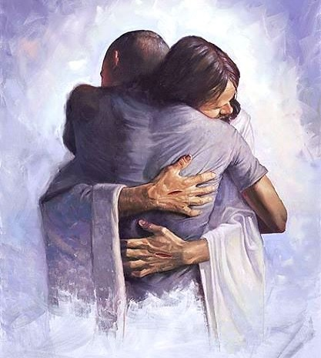
BLESSINGS TO YOUR FAMILY!
A BIG HUG
FOR YOU!

